Slide 1
Detecting Alzheimer's Disease by Applying Convolutional Neural Network to MRI Scans
Team Thinkers
Dongho Lee
Christian Yan
Professor Barnabas Bede
CSP 200
Fall 2021
Notes:
Hello Professors, we are team thinkers and we came back with a new project idea for CSP 200. I am Dongho Lee, and I am Christian Yan. Our new project will be the detection of Alzheimer’s using convolutional neural network on MRI scans.

Slide 2
Outline
Why Alzheimer’s Disease?
How Is Alzheimer’s Diagnosed?
Convolutional Neural Networks
What Does a Typical Dataset Look Like?
Challenges
Weekly Goals
Notes:
First we will go over our motivation for choosing this topic, then how MRI scans help with the diagnosis of Alzheimer’s disease.
We will briefly explain how convolutional neural networks work, which is the algorithm we chose for this project.
We will also show you how the training/validation dataset looks like.
In the end, we will talk about the challenges and our future plans.

Slide 3
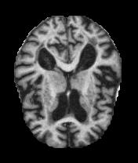
Why Alzheimer’s Disease?
Alzheimer’s cannot be cured but early detection and intervention are extremely important
More than 3 million cases in the US alone
Expected to increase in developed countries as populations grow older
we need an effective way to diagnose
Source: https://www.kaggle.com/legendahmed/alzheimermridataset
Notes:
As you probably know, Alzheimer’s disease causes dementia. There is no cure right now but early detection can slow this down a lot.
It’s very common yet very devastating, and as developed countries’ populations grow older, we will see an huge growth in the number of Alzheimer’s patients.
This is why we need to speed up the diagnosis process.

Slide 4
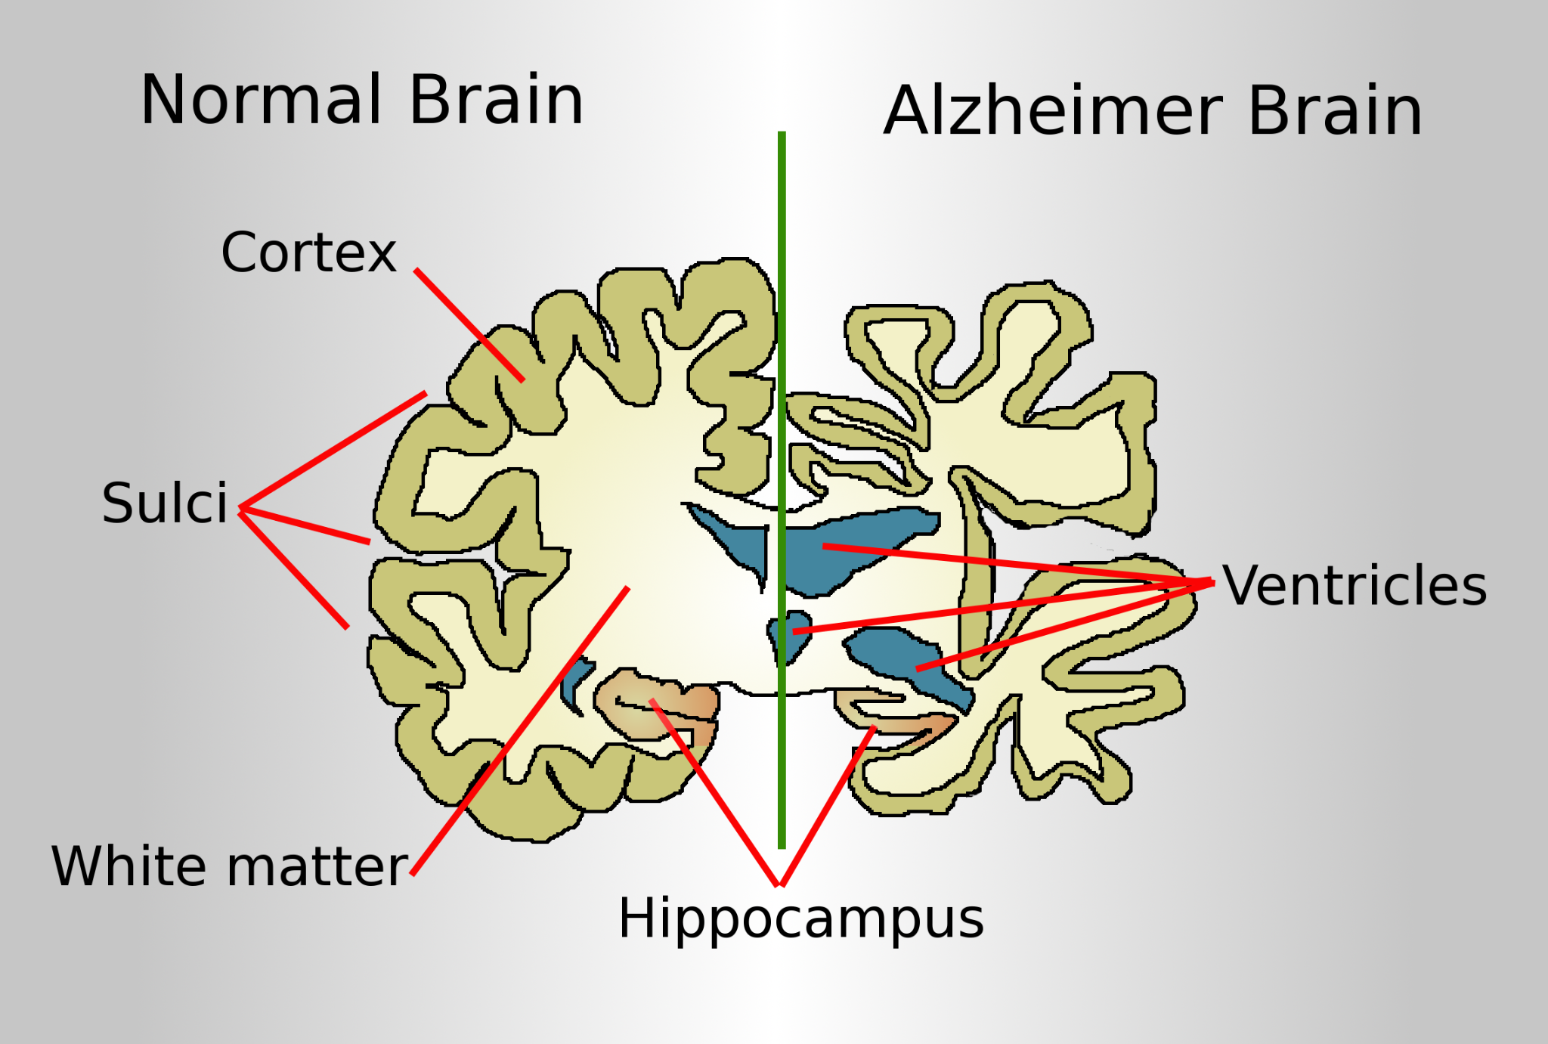
How Is Alzheimer’s Diagnosed?
Usually diagnosed through
medical history
family history
behavior observation
MRI scans can be used to detect brain anomalies specific to Alzheimer’s, ruling out other diseases and saving time for the patient
Source: https://commons.wikimedia.org/wiki/File:Brain-ALZH.png
Notes:
Although Alzheimer’s is not primarily diagnosed through MRI scans, it can save a lot of time by ruling out other diseases first before doing more in-depth tests.
For example, we can see in the image that the brain cortex is thinner and the ventricles are larger in Alzheimer brain.

Slide 5

Convolutional Neural Networks
A convolutional neural network consists of 3 types of layers
1. Convolutional layers 2. Pooling layers 3. Fully connected layer

Slide 6
CNN - Convolutional Layer
Converts image data into digestible numerical data for the neurons
Source: https://towardsdatascience.com/a-comprehensive-guide-to-convolutional-neural-networks-the-eli5-way-3bd2b1164a53
Notes:
The input image is shown as green squares and the kernel (filter) is shown as orange squares. As the kernel takes strides on the image, the convolved feature matrix is created

Slide 7
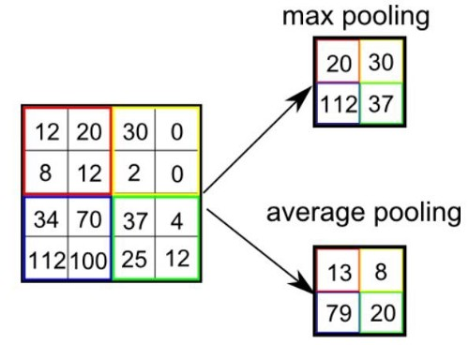
CNN - Pooling Layer
Simplifies a high-resolution array into a low-resolution array, reducing the burden on the machine learning algorithm itself
Max pooling (works better)
Average pooling
Source: https://towardsdatascience.com/a-comprehensive-guide-to-convolutional-neural-networks-the-eli5-way-3bd2b1164a53

Slide 8
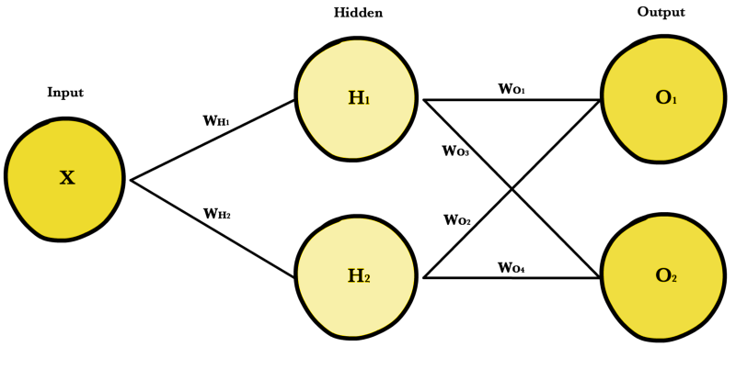
CNN - Fully Connected Layer
AKA feedforward neural network
Input values > neurons > output values > summation > single output
Analogous to a group of students working on a problem set, then collecting their answers to predict the correct answer

Slide 9
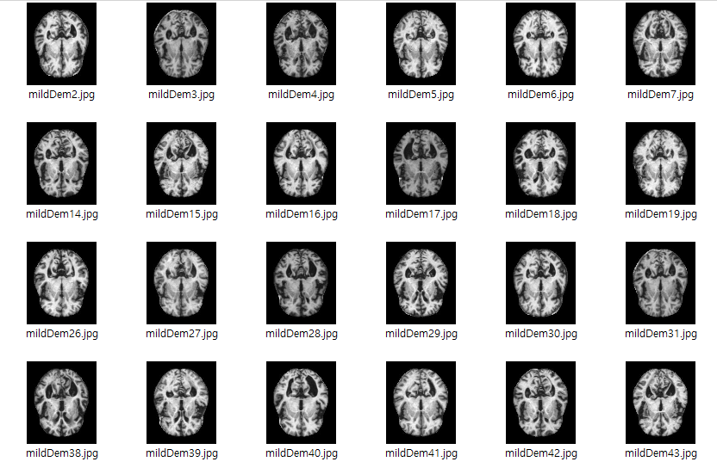
What Does a Typical Dataset Look Like?
MRI images are categorized into 4 groups
No dementia
Very mild dementia
Mild dementia
Moderate dementia
Hard to detect mild or very mild cases through human eyes. We attempt to overcome it through machine learning.
Notes:
Our dataset consists of thousands of MRI scans with dimensions of 176 by 208, divided into 4 categories depending on severity. We are planning to build a 2-way classification system following Professor Bede’s advice, and may expand it to a 4-way classification if this works out well.

Slide 10
Challenges
Currently:
No prior experience with machine learning
The team is smaller than expected
In-person meetings are limited since we are not on campus often
In the future:
The dataset we currently have is only comparing normal vs Alzheimer’s patients. For this to be useful in real life, the AI also needs to be trained to distinguish Alzheimer’s from other brain diseases.
Notes:
The challenges we are dealing with right now are the following:
we do not have any experience with machine learning,
and the team is smaller than expected,
communication is harder and slower because in-person meetings are limited since we are not on campus often
In the future when our machine learning algorithm is more mature, we will need to take into account that this is used for differential diagnoses, meaning that it’s supposed to distinguish other diseases from Alzheimer’s as well, not just distinguish it from a healthy brain. So we will need to train the algorithm for other diseases like Parkinson’s disease.

Slide 11
Weekly Goals
Week # | Dates | Goals
6 | Oct 3-9 | Build improved demo code (add more conv and pooling layers)
7 | Oct 10-16 | More research into CNN (Google Scholar article)
8 | Oct 17-23 | Improvement 1 - increase the # of epochs to see its effect on accuracy
9 | Oct 24-30 | Improvement 2 - increase the # of convolution-pooling cycles
10 | Oct 31-Nov 6 | Improvement 3 - regression models (softmax & cross-entropy)
11 | Nov 7-13 | Improvement 4 - build a preprocessor using DBSCAN (detect ventricles and a decrease in brain volume)
12 | Nov 14-20
13 | Nov 21-27 | Train using more diverse datasets (Google, Kaggle & ImageNet)
Notes:
This is a table of our weekly goals, which largely consist of 2 parts: improvement milestones on our convolutional neural network, and then a preprocessor milestone.

Slide 12
References
Y. LeCun, L. Bottou, Y. Bengio, and P. Haffner, “Gradient-Based Learning Applied to Document Recognition,” in IEEE, November 1998, pp. 1-46.
J. Islam and Y. Zhang, “Brain MRI analysis for Alzheimer’s disease diagnosis using an ensemble system of deep convolutional neural networks,” in Brain Inf., 31 May 2018.

Slide 13

Thank you
Any Questions?

